Slide 1
Study of PFC deadlock
What is the necessary condition for PFC deadlock to occur?
How long will it take to create a PFC deadlock when the deadlock condition is met?

Slide 2
Study of PFC deadlock
Five important factors:
TTL value | hop number | input rate | PFC threshold | Size of sender buffer (burst size)
k_{ttl} | n | r | t_{PFC} | m
*size of sender buffer: the bytes of packets a sender can send to the receiver without receiving any responses (e.g., the bytes of messages an RDMA sender can send to the receiver without receiving any ACKs).
When there is a loop in the network, whether a PFC deadlock will occur is determined by all these five factors.
When the deadlock condition is met, the time to create a PFC deadlock is determined by the first four factors.

Slide 3
Study of the necessary condition to create PFC deadlock

Slide 4
Study of the necessary condition to create PFC deadlock
Part A:
TTL value | hop number | input rate | PFC threshold | Size of sender buffer
k_{ttl} | n | r | ∞ | ∞
Modeling and experiments. Already discussed.
Part B: study the impact of PFC threshold.
TTL value | hop number | input rate | PFC threshold | Size of sender buffer
k_{ttl} | n | r | ? | ∞
Part C: study the impact of size of sender buffer.
TTL value | hop number | input rate | PFC threshold | Size of sender buffer
k_{ttl} | n | r | ∞ | ?

Slide 5
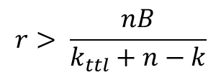
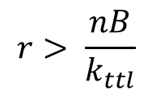
Basic model
TTL value | hop number | input rate | PFC threshold | Size of sender buffer
k_{ttl} | n | r | ∞ | ∞
r
B - r_{d}
Lower-bound rate for queue to build up:
Case 1: packets are dropped at the congestion hop (hop 1).
$$r> \frac{nB}{k_{ttl}}$$
B
Case 2: packets are dropped at some uncongested hop (hop k).
$$r> \frac{nB}{k_{ttl}+n−k}$$

Slide 6
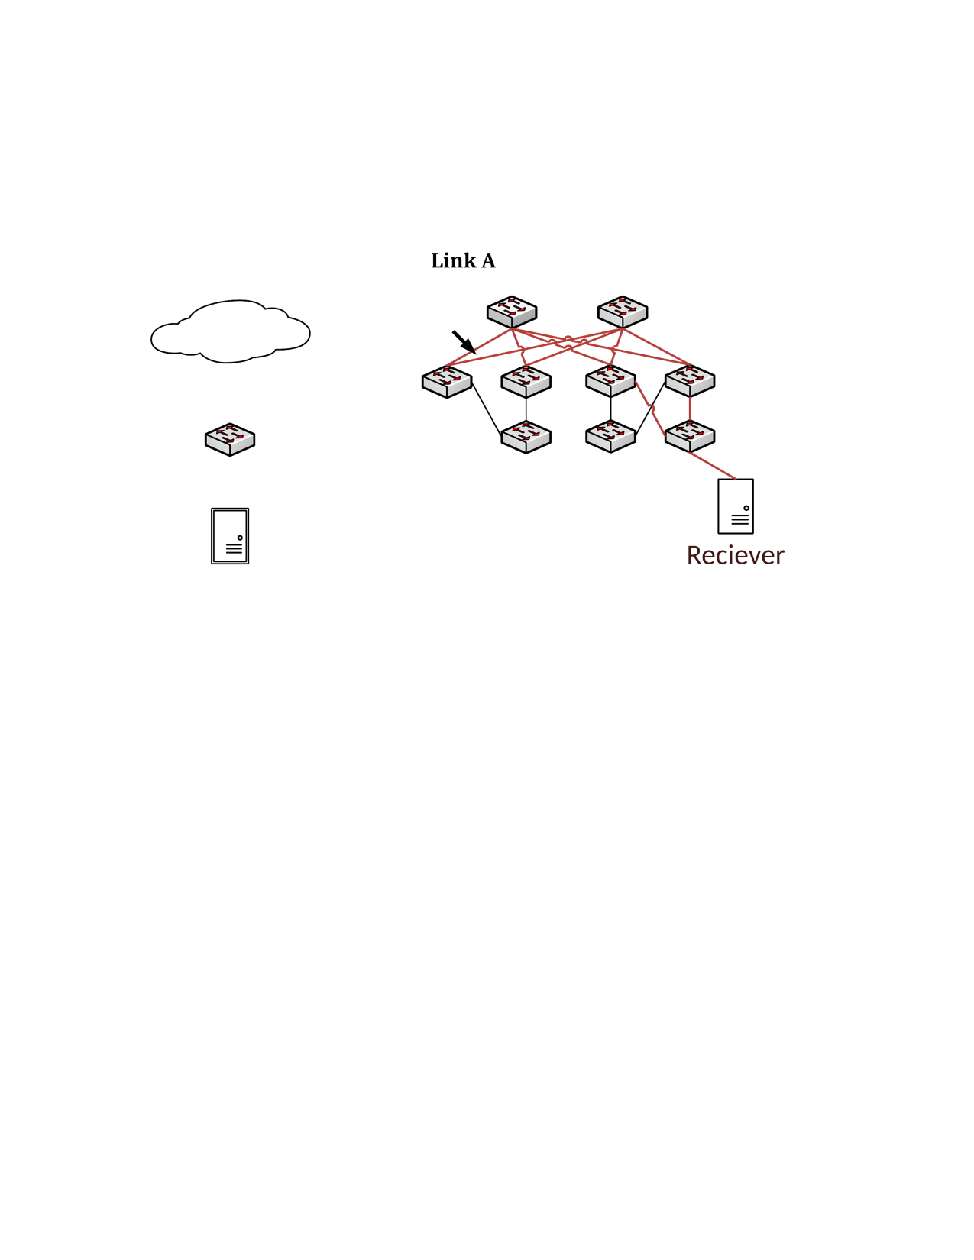
Verification of basic model
S1
S2
L1
L3
L4
172.16.4.0/31 -> T4
1
2
Inject lossy UDP traffic
30
30
172.16.4.5/32 -> L4
T1
T3
T4
PFC threshold = ∞, Sender buffer = ∞
H1: 172.16.3.6
H2: 172.16.4.5

Slide 7
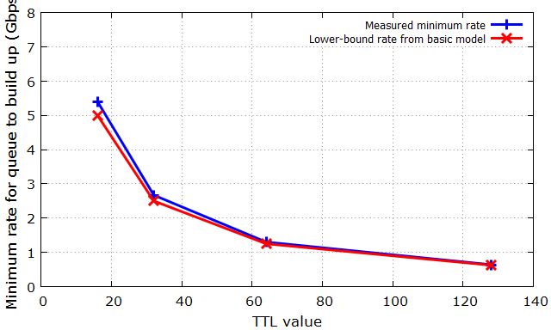
Verification of basic model
Measurement of the minimum input rate r at which queue will build up:
Observation: basic model provides a good lower-bound rate above which queue will build up.

Slide 8
Study the impact of PFC threshold
Part B: study the impact of PFC threshold.
TTL value | hop number | input rate | PFC threshold | Size of sender buffer
k_{ttl} | n | r | ? | ∞
Experiment-A: given fixed k_{ttl}, n, we measure the minimum rate r_{min} that can create PFC deadlock under different PFC threshold t_{PFC}.
Experiment-B: given fixed PFC threshold t_{PFC} and n, we measure the minimum rate r_{min} that can create PFC deadlock under different TTL value k_{ttl}.
The purpose of experiment-B is to study whether the basic model can still provide a good lower-bound rate when PFC threshold is considered.

Slide 9
Study the impact of PFC threshold: experiment setting
S1
S2
L1
L3
L4
172.16.4.0/31 -> T4
1
2
Inject Lossless UDP traffic
30
30
172.16.4.5/32 -> L4
T1
T3
T4
Sender buffer = ∞
H1: 172.16.3.6
H2: 172.16.4.5

Slide 10
Study the impact of PFC threshold: experiment-A
Measurement of the minimum input rate at which PFC deadlock will occur:
α | 1/16 | 1/8 | 1/4 | 1/2
PFC threshold (MB) | 0.706 | 1.333 | 2.400 | 4.000
Minimum input rate to create PFC deadlock (Gbps) | 0.64 | 0.64 | 0.64 | 0.64
* TTL = 128, sender buffer = ∞.
Observation: PFC threshold doesn’t have an obvious impact on the minimum rate to create PFC deadlock.
*But as we will show later, PFC threshold has impact on the time to create PFC deadlock: a larger PFC threshold requires more time to create PFC deadlock.

Slide 11

Study the impact of PFC threshold: experiment-B
Measurement of the minimum input rate at which PFC deadlock will occur:
Observation: our basic model does not consider the impact of PFC deadlock, but it still provides a good lower-bound input rate when PFC threshold is considered.

Slide 12
Study the impact of sender buffer
Part C: study the impact of size of sender buffer.
TTL value | hop number | input rate | PFC threshold | Size of sender buffer
k_{ttl} | n | r | ∞ | ?

Slide 13
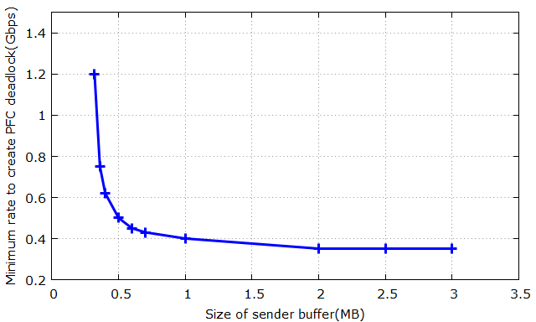
Study of the impact of sender buffer: experiment results
Measurement of the minimum rates to create PFC deadlock under different sizes of sender buffer:
As we increase the size of sender buffer, the minimum input rate to create PFC deadlock decreases;
There is a lower-bound input rate (~0.35Gbps) to create PFC deadlock.

Slide 14
Study of the time to create PFC deadlock

Slide 15
Measurement of the time to create PFC deadlock
Testbed setup:
S1
S2
Port mirroring path
L1
L3
L4
172.16.4.0/31 -> T4
1
2
Lossless UDP traffic
30
30
172.16.4.5/32 -> L4
T1
T3
T4
H1: 172.16.1.2
H2: 172.16.3.6
H3: 172.16.4.5

Slide 16
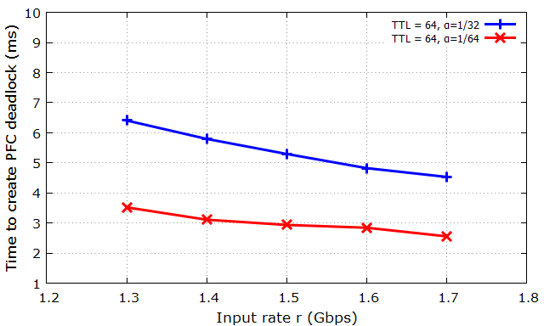
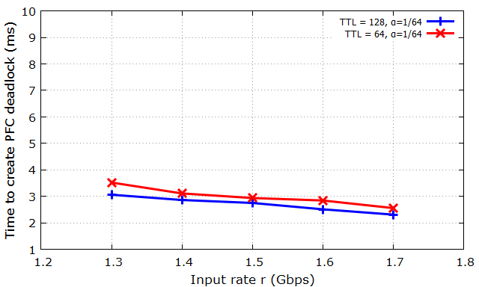
Measurement of the time to create PFC deadlock
As the input rate increases, the time to create PFC deadlock decreases accordingly;
Given a fixed input rate, a larger PFC threshold requires more time to create PFC deadlock;
Given a fixed input rate, a smaller TTL value requires more time to create PFC deadlock.

Slide 17
Analysis of the time to create PFC deadlock
Let r be the input rate, s be total occupied switch buffer when PFC deadlock occurs, r_{d} be the maximum drain rate ( when queue length is 0).
A lower-bound time to create PFC deadlock (no packets are dropped by TTL expiration) : s/r.
An upper-bound time to create deadlock (Packets are dropped by TTL expiration at the maximum rate) : s/(r-r_{d}) .

Slide 18
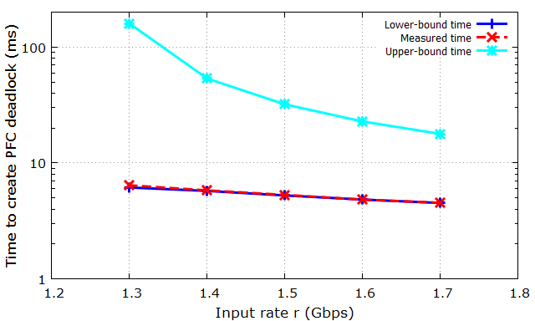
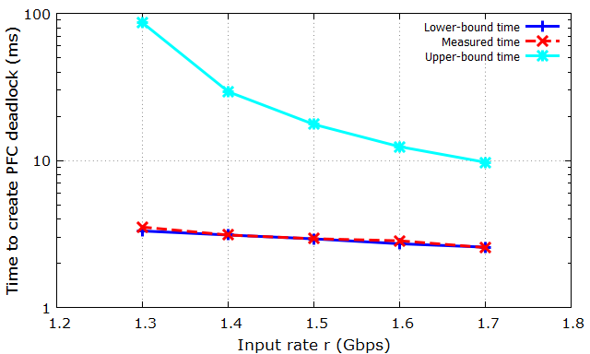
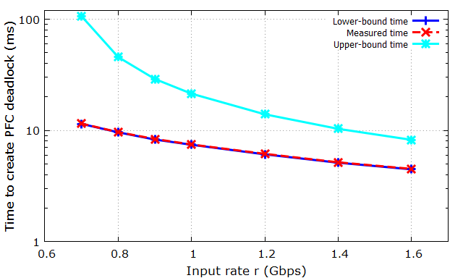
Analysis of the time to create PFC deadlock
(a) Setting: TTL = 64, α = 1/32 (no PFC deadlock when r < 1.3Gbps).
(b) Setting: TTL = 64, α = 1/64 (no PFC deadlock when r < 1.3Gbps)..
Measured time is closed to the lower-bound time.
As the input rate increases, Measured time becomes closer to the upper-bound.
(a) Setting: TTL = 128, α = 1/32 (no PFC deadlock when r < 1.3Gbps).

Slide 19
Analysis of the time to create PFC deadlock
Drain rate r_{d} is affected by two factors: queuing delay and PFC pause. Input rate r is affected by PFC pause.
As shown in the figures, the impact of drain rate r_{d} can be simply ignored. It implies:
PFC pause has larger impact on the drain rate than input rate.
Queuing delay has significant impact on drain rate.

